Slide 1
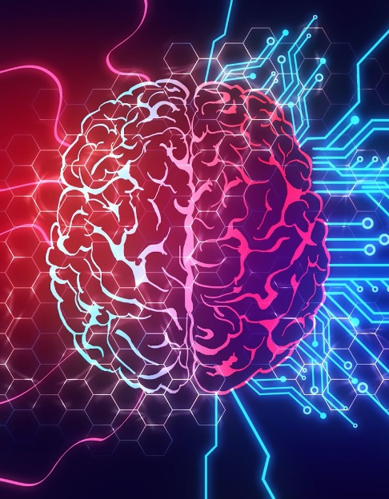
Selected - 1
Number Team : 5

Slide 2
Faculty Name : Computers and artificial intelligence Helwan
Team members’ IDs and names.
.1محمد كمال عبدالحفيظ محمد202000812
.2احمد محمد محمد امام 202000076
.3احمد عصام عبدالفتاح العدل202000051
.4احمد جمال حسيني علي202000022
.5احمد محمود حمادة محمود202000081
.6مصطفى حماده جمال محمد202000899
.7عبدالله أشرف السيد أحمد 202000544

Slide 3

Numerical dataset
General Information :
1. The Name Dataset :
Data for Admission in the University
2. Number of Classes : 8
Their Labels: 2
3.Total Number of Samples : 400
4.Number of Training : 300
Number of Testing : 100
5.Test_size=0.25

Slide 4
Implementation Details:
1. At feature extraction phase : There is no in the model
2. Is cross-validation used? NO
3.Hyperparameters used:
1. Learning Rate = 1.0
2. max_iter=100
“We use max_iter=100, stopped in 26 iterations“
3. test_size = 0.25
6.penalty=l1
5.shuffle=true
7. solver=sag

Slide 5
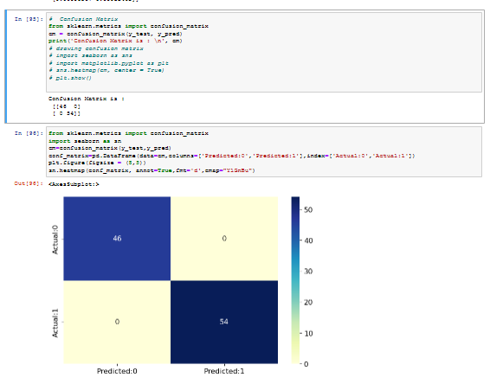
Results Details:
1. Confusion Matrix:

Slide 6
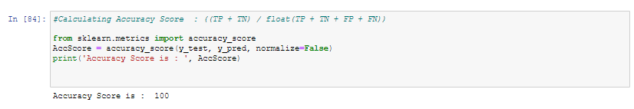
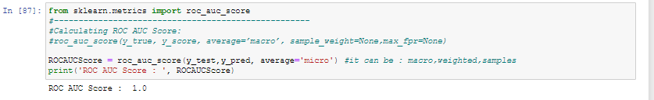
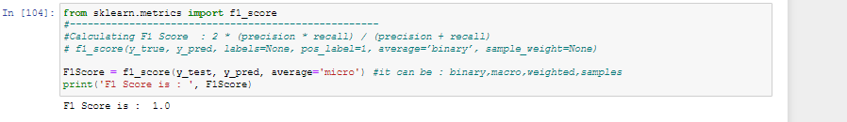
2. Accuracy :
3. roc_auc :
4. Fl_score :

Slide 7
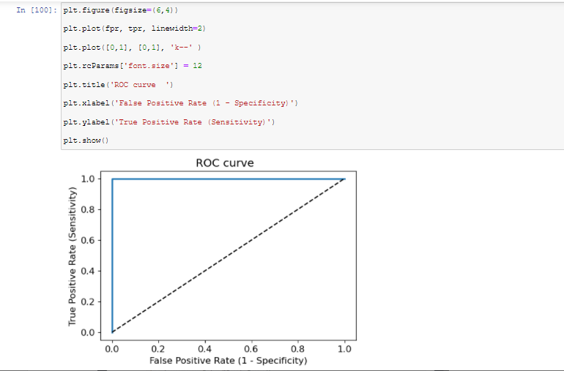
5. ROC Curve:

Slide 8
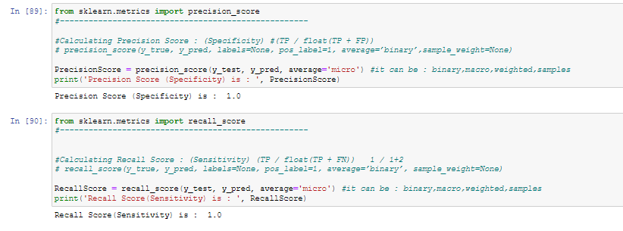
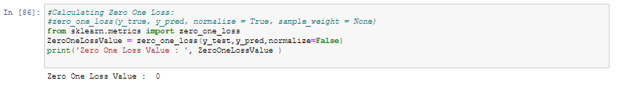
6. Pecificity & Sensitivity :
7. Zero One loss:

Slide 9
Implementation Details:
1. At feature extraction phase : There is no in the model
SVM
Implementation
2. Is cross-validation used? NO
3.Hyperparameters used:
1. Learning Rate = 1.0
2. max_iter=100
3.Kernel=sigmoid
4.gamma=auto
5. test_size = 0.25
6.shuffle=true
7.random_state=4

Slide 10
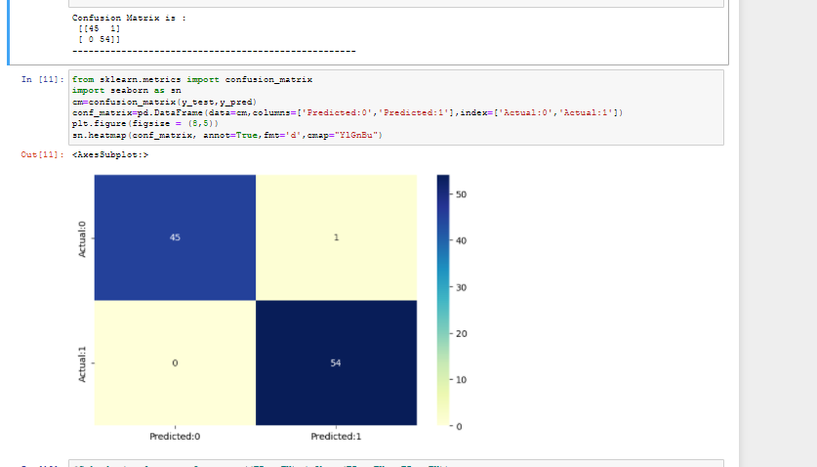
Results Details:
1. Confusion Matrix:

Slide 11
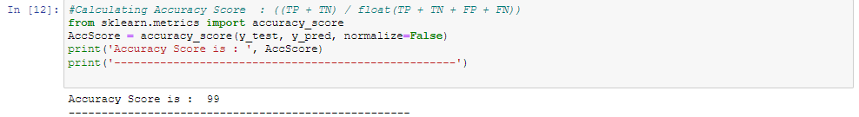
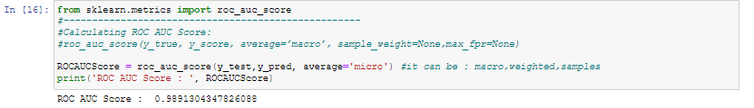
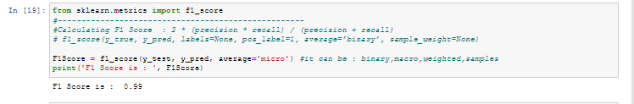
2. Accuracy :
3. roc_auc :
4. Fl_score :

Slide 12
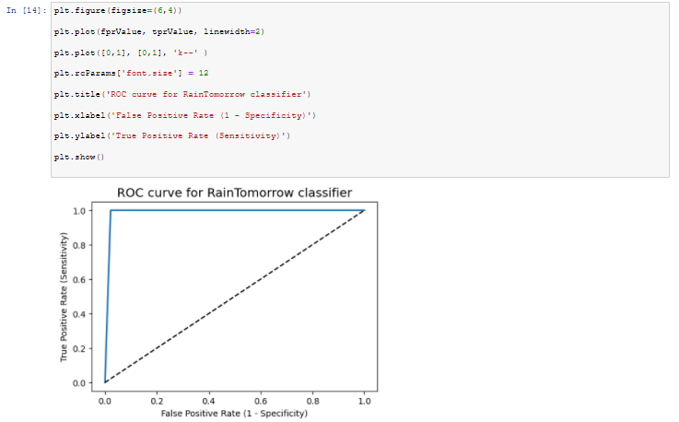
5. ROC Curve:

Slide 13
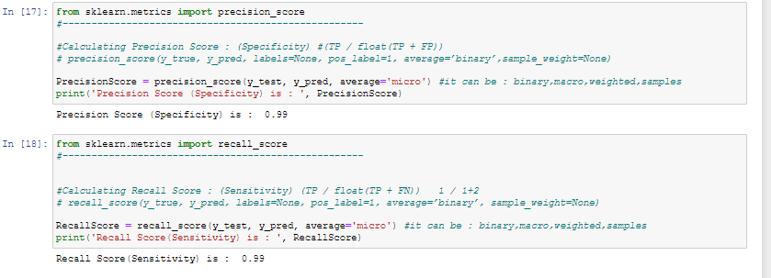
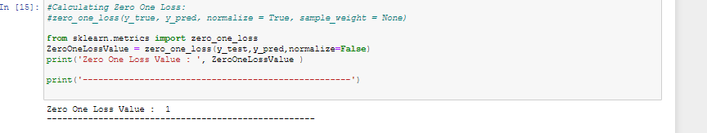
6. Pecificity & Sensitivity :
7. Zero One loss:

Slide 14
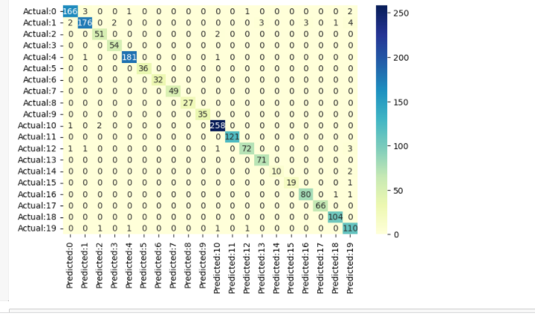
SVM
Results Details:
1. Confusion Matrix:

Slide 15
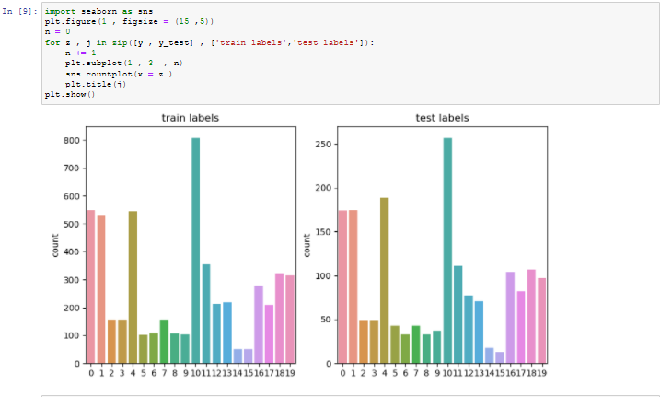

Slide 16
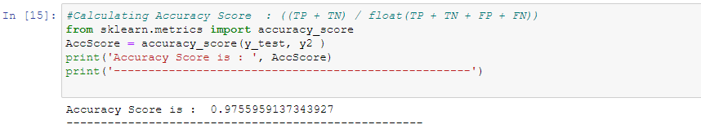
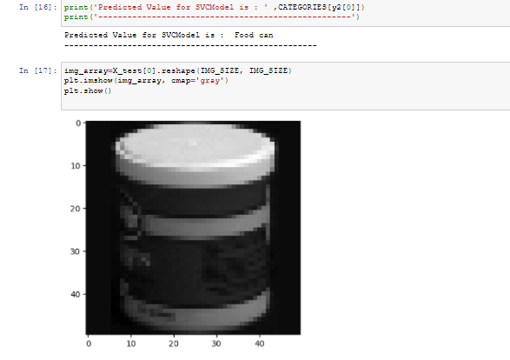
2. Accuracy :

Slide 17
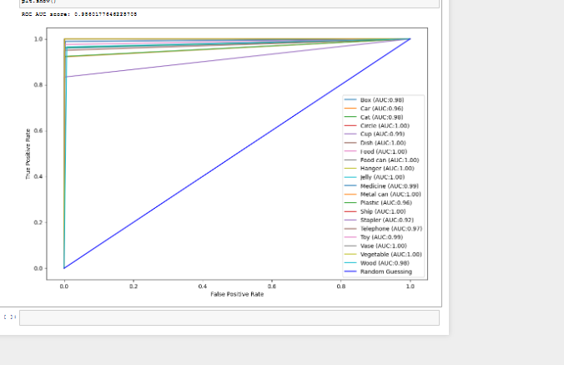
3. ROC Curve:

Slide 18
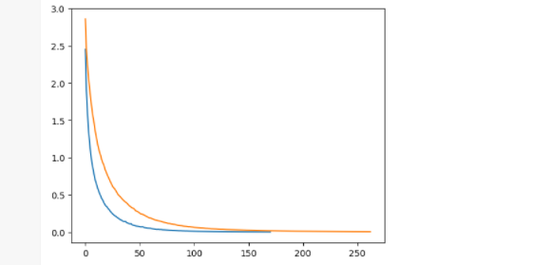
4. Loss Curve:

Slide 19

Thank you

